Slide 1


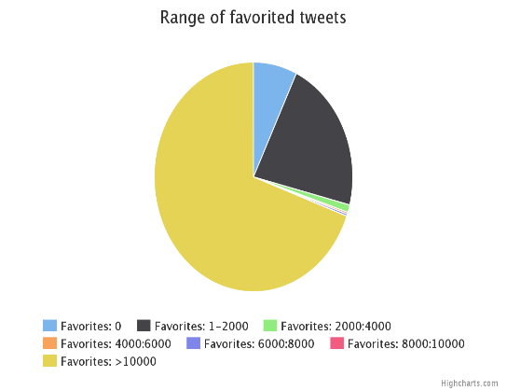
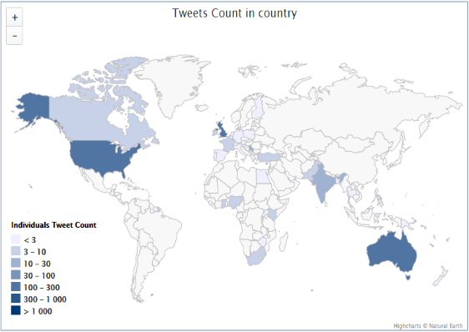
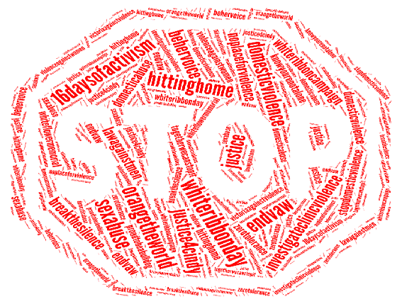
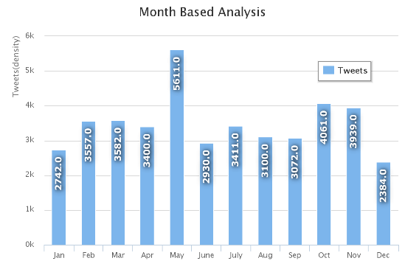
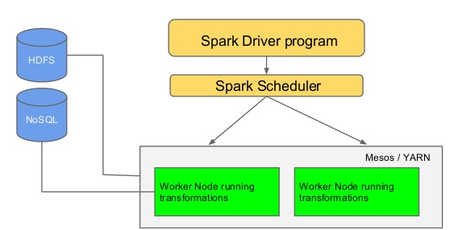

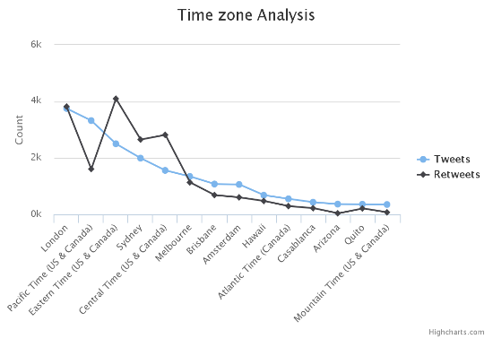
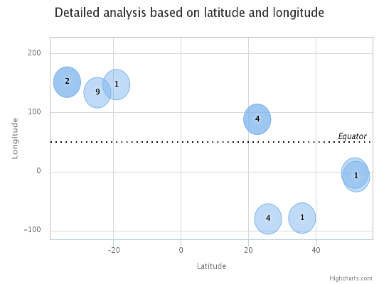
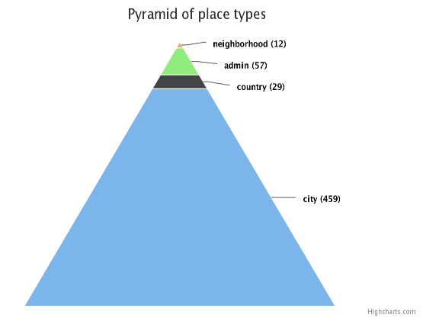
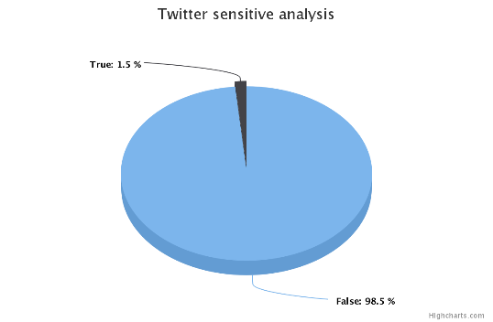
Twitter Analysis report on Domestic Violence
By
Priyadarsini Nidadavolu
Technologies
Query 1
Query 2
Query 3
Query 4
Spark
Scala
Python
JavaScript
High Charts
Monthly Analysis of Tweets on Domestic Violence
Favorite Tweets Analysis
Location Analysis
Word Frequency analysis based on #HashTags
Architecture
Query 5
Query 6
Query 7
Query 8
Comparison based on Time Zones for Tweets and Re-Tweets
Sensitivity Analysis
Analysis based on Latitude and Longitude positions
Analysis based on Place Type

